Slide 1
Business Assessment
Outvio’s Test Task
Guilherme Azambuja
05/07/2022

Slide 2
Agenda
01
02
03
04
Problem
Task resume and presentation of given data
Current price model analysis
Extraction of information from the current price model, Key Insights and Opportunities
Building a Rational
Define assumptions and goals for create a suggestion
Final Model
Module prices, pros and cons

Slide 3
01
Problem
What is the task goal?

Slide 4
Given Pricing Data
 | Launch | Grow | Conquer
% of clients | 50% | 30% | 20%
Subscription fee | €29 | €99 | €199
ARPU* | €70 | €180 | €480
Fee per order (avg.) | €0.09 | €0.08 | €0.05
Modules**
Fulfillment | ❌ | ❌ | ✅ (30%)
Shipping | ✅ (100%) | ✅ (100%) | ✅ (90%)
Notifications | ❌ | ✅ (50%) | ✅ (80%)
Returns | ✅ (40%) | ✅ (90%) | ✅ (75%)
Goal: The task goal is to refactor the current price model in a more modular way, minimizing losing any current revenue from existing clients and maximizing future revenue from future clients.

Slide 5
02
Current Model Analysis
What are the key insights that we can use to better understand the clients behavior?

Slide 6




Analyzing the Current Price Model
Reorganizing the given data, it was possible to extract some useful information. The table below presents the reorganized data.
 | Current Plan
 | Launch | Grow | Conquer
% Clients | 50 | 30 | 20
ARPU (Euros) | 70 | 180 | 480
Subscription Fee (Euros) | 29 | 99 | 199
Order Fee (Euros) | 0,09 | 0,08 | 0,05
Gross Income from Subsc. Fee * | 1450 | 2970 | 3980
Gross Income from Order Fee * | 2050 | 2430 | 5620
Gross Income * | 3500 | 5400 | 9600
Income Share | 19% | 29% | 52%
Orders per Client (average) | 456 | 1013 | 5620
$$\% of clients ∗Subscription Fee$$
$$\% of clients ∗Order Fee$$
$$\% of clients ∗ARPU$$
$$\frac{(ARPU −Subscription Fee)}{Order Fee}$$
* For simplicity, 1% of clients was considered equal to 1 client. This allowed analyze the proportional income distribution.

Slide 7
Main insights
Income source
# Orders vs Subscription Fee
Income share per Fee
The average of orders per client grows along with the Subscription Fee of its contracted plan.
Most of Launch and Conquer Plans income comes from Order Fees, while Grow Plan income mostly come from Subscription Fee.
The major income share comes from the Conquer plan.
Opportunities
60% of Launch Plan clients pay for Returns and don’t use it.
50% of Launch Plan clients pay for Notification and don’t use it.
70% of Conquer Plan clients pay for Fullfilment and don’t use it.
Apparently, those clients that pay for higher plans and only uses Low-Level features are mainly interested on cheaper Order Fees.

Slide 8
03
Building a Rational
How can we use the previous information for developing a new price model?

Slide 9
Assumptions
In order to create a price model that supplies Outvio’s cost and that keeps profitable, I defined some criterias that each module price would need to verifies. In this slide, when I talk about features cost I’m focused on Outvio’s cost for providing each service.
Tracking Cost
Fullfilment Cost
1
2
Assuming that the tracking cost is covered by an increase of 70 euros, which is the price difference between Launch and Grow plans.
considerind the fulfillment cost covered by an increase of 100 euros, which is the difference between Grow and Conquer plans.
Shipping and Returns Cost
Shipping Price
3
4
Considering that Returns and Shipping features have its costs covered by the Launch plan price.
In order to reduce the entry barrier, the Shipping feature needs to cost less than 29 euros. Shipping feature is the most used feature, so it is more likely to be the top sold service.

Slide 10
Rational
First step: Determine how many clientes uses each feature nowadays and assume that after the price model change they will still pay for those services.
Demand Forecast
Interpreting the total column from the left table:
Shipping would be contracted by 98% of the client base.
Return would be contracted by 62% of the client base.
Tracking would be contracted by 31% of the client base.
Fullfilment would be contracted by 6% of the client base.
Distribution of the % of total clients within each plan and each feature
Modules | Launch | Grow | Conquer | Total
Shipping | 50 | 30 | 18 | 98
Return | 20 | 27 | 15 | 62
Tracking | 0 | 15 | 16 | 31
Fullfilment | 0 | 0 | 6 | 6

Slide 11
Rational for Subscription Fees
Second step: Assume that the total income from subscription fee and order fee will be the same and divide the total value per each feature, weighting by the % of clientes that will buy it.
The prices were arbitrarily chosen in order to ensure business necessities mentioned on slide 9:
Shipping needs to cost less than 29 euros.
Tracking needs to cost at least 70 euros.
Fullfilment needs to cost at least 100 euros.
Keep the total income equals to 8400 euros (total Subscription Fee calculated at slide 6).
Prices rounded to end with ,99, since it increases the value perception of clients. Quick source: https://www.entrepreneur.com/article/279464
Module | Income per Module | Usage (% of clientes) | Price
Shipping | € 1.959,02 | 98 | € 19,99
Return | € 2.478,76 | 62 | € 39,98
Tracking | € 3.098,45 | 31 | € 99,95
Fullfilment | € 959,52 | 6 | € 159,92
Total Income | € 8.495,75

Slide 12
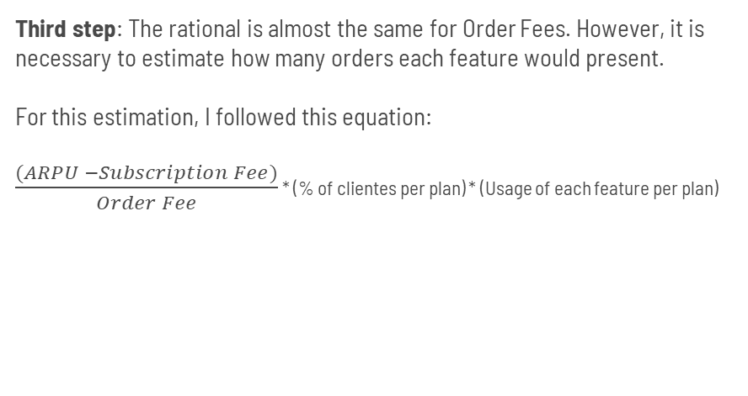
Rational for Order Fees
Third step: The rational is almost the same for Order Fees. However, it is necessary to estimate how many orders each feature would present.
For this estimation, I followed this equation:
$\frac{(ARPU −Subscription Fee)}{Order Fee}$ * (% of clientes per plan) * (Usage of each feature per plan)
Module | Income Share | Orders | Price | Price per order
Shipping | € 3.087,00 | 154350 | € 3.087,00 | € 0,02
Return | € 2.415,42 | 120771 | € 2.415,42 | € 0,02
Tracking | € 3.153,45 | 105115 | € 3.153,45 | € 0,03
Fullfilment | € 1.686,00 | 33720 | € 1.686,00 | € 0,05
Total | € 10.341,87
The prices were arbitrarily chosen in order to keep the same total income from order fees (10100 euros) and to reduce the entry barrier by reducing the Shipping Order Fee.

Slide 13
04
Final Model
Final suggestion for Subscription Fees and Order Fees

Slide 14
Final Model
Module | Price | Price per order
Shipping | € 19,99 | € 0,02
Return | € 39,99 | € 0,02
Tracking | € 99,99 | € 0,03
Fullfilment | € 159,99 | € 0,05
Pros
Keep the same income from Subscription Fee and Order Fee
Reduce Entry Barrier, by reducing Shipping subscription and order fees
Allow clients to contract only features that are usefull
Cons
Although the model decreases the entry barrier, it increases the barrier for clients that needs all features at the same time
Since there was no data regarding the demand of Desk feature, it was not possible to estimate its optimal prices; However, once the data is available it is easy to reproduce the rational including Desk information.

Slide 15
Thank you!

